Slide 1
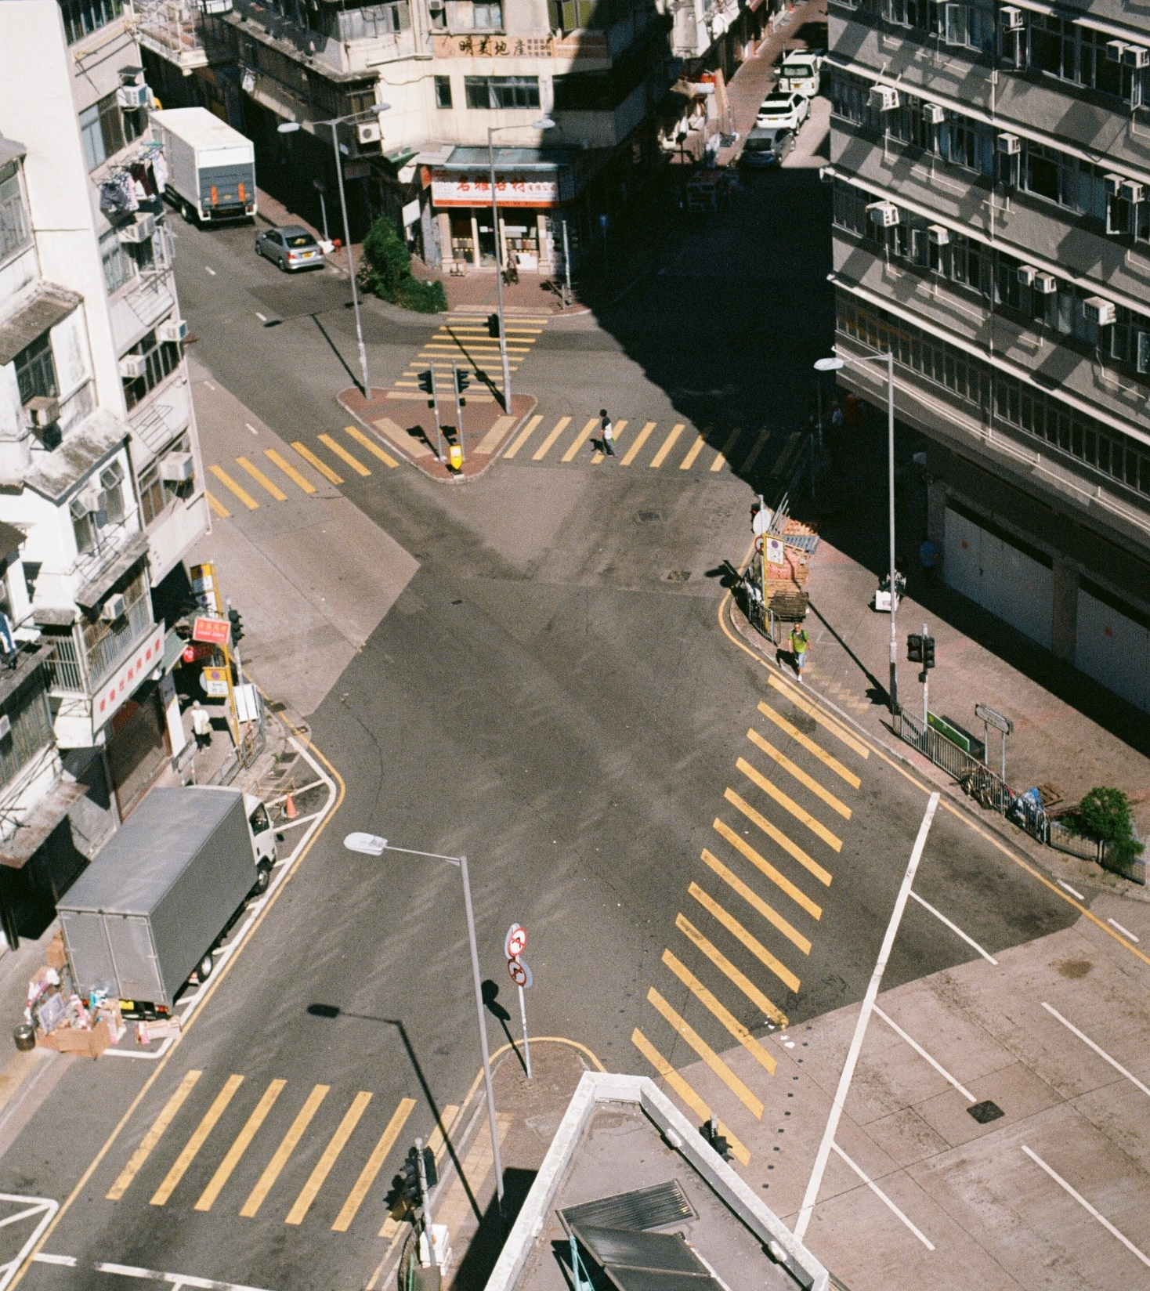
Assessing Demand-side mitigation options
Anjali Ramakrishnan
PhD Researcher – WG II Land Use, Infrastructure and Transport
Ramakrishnan@mcc-berlin.net

Slide 2
IPCC AR 5
Negative Emission Technologies (NETs)
Low Carbon Supply
Large-scale energy supply technologies
Energy Demand Reductions
Immediate and near-term target
Technical and Financial credibility yet to be demonstrated
Cannot solely deliver rapid and deep emission cuts to stay below 2℃
Essential Complement to ongoing supply side measures
IPCC AR6 – Chapter 5 WG III
“Demand, services and social aspects of mitigation”
Notes:
The IPCC fifth assessment report assumed the availability and use of CO2 removal technologies - Carbon Capture, BECCS, Geoengineering etc – to lower the global mitigation rates. However, the feasibility of these technologies is yet to be demonstrated.
Alongside, is the planning, construction and commissioning of large scale low energy carbon supply technologies – renewables, energy efficiency – it can not alone deliver the emission cuts that’s urgent to stay below 2 degrees.
This adds the spotlight to demand reduction in the immediate and near term as a complementary action towards emission reduction. This is now being endorsed by the IPCC through a chapter in the next assessment report.

Slide 3








Participate effectively in society
Pre-defined Energy Services
Access (infrastructure, resource)
Prices/Income
Technology, etc.
Demand?
>, =, <
Consumption
Social Practices/Systems + Infrastructure of provision
Lifestyles
Primary Objective:
Wellbeing
Social Norms and Culture
Behaviour/Routines

Slide 4
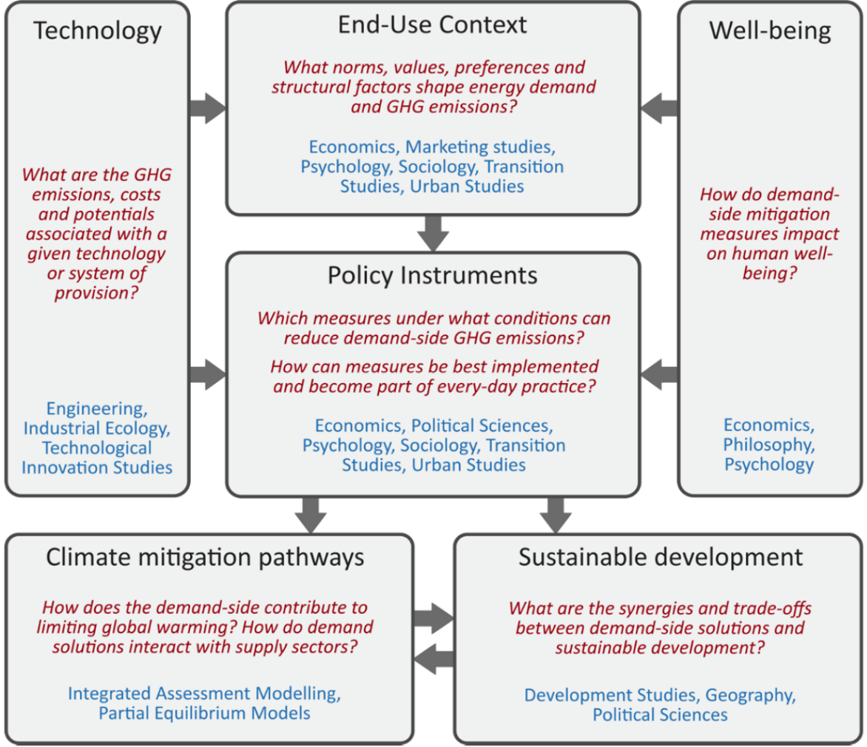
Interdisplinary efforts required to assess demand-side solutions
A systematic assessment of the demand-side and services requires multi-disciplinary coordination
Key issues:
Normative framing
Demand-side framework of potential
Context-dependent transitioning (policies/ collective action) strategies
Creutzig et al, Nature Climate Change, 2018
Notes:
Starting point is characterizing demand-side patterns and the associated emission levels - choices between alternative strategies
Second – Policy perspective and potential to reduce GHG – constraints, feasibility – further how well can they be embedded in daily routines and practices – different disciplines approach this stage with varied pespectives. – Psychoclogy – no perfect rationality; Sociology - Social Practice theory – socio-demographics, inequality etc.; Economics – welfare function; policies that address social norms may lead to large scale tipping points.
Third – Costs and potentials for emission reduction (through policy instruments), given the system dynamics
Fourth – wellbeing – often conflicting interests
Fifth – climate change mitigation – how the mesures play up on a global scale when interacting with supply system
Sixth – demand side assessments should be able to inform the SDGpathways – articulated in the Paris agreement language through “national determined”

Slide 5

Demand-side sectors strongly linked to human well-being
URBAN CENTERS
RURAL AREAS

Slide 6
Cities and Human Wellbeing
Transport Sector
First order – Social Inclusion (Accessibility), Comfort, Freedom to Travel, Safety, Travel cost
Second order – Health, Status (social acceptance) – economic and environmental, Congestion
(Contextual – dependent on existing infrastructures and institutions)
Buildings Sector
First order – Shelter, Thermal Comfort, Security,
Second order – Status symbol, Street temperature (Urban Heat
Island effect)
Conflicting Preferences
Passive Housing/Retrofitting versus Car Purchase
Perceived Wellbeing

Slide 7
Rural well-being
Access to clean cooking practices
Health (Indoor Air Pollution), Productive time (women and children), Reduced drudgery
Access to Electricity – lighting, appliance use
Late evening activities – cooking, studying, extend market hours etc., Safety, Income, Productivity
Additional consumption expenditure - cost of cooking fuel, electricity charges - as a result of access would have negative wellbeing impacts

Slide 8
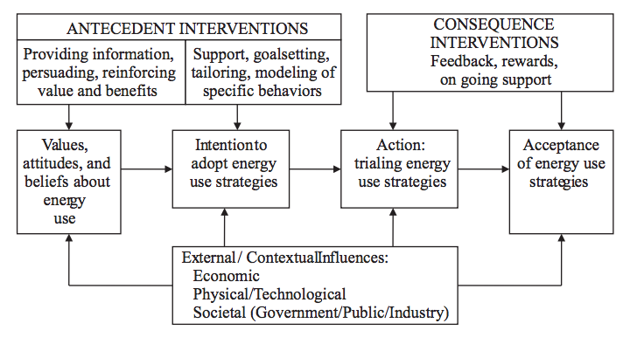
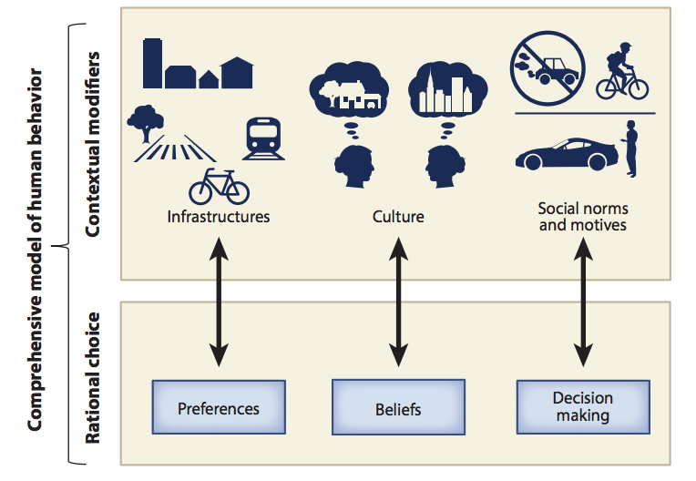
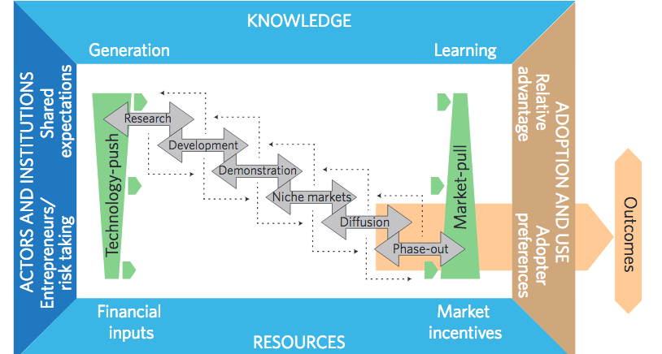
How do we assess options and progress research?
Gardner and Ashworth (2008): Synthesis of models and approaches
for behavioural and attitude change for energy use.
Creutzig et.al (2015); Mattauch et. al (2016) Comparing behavioural and rational choice approaches
Wilson et. al (2012): Analytical framework of the innovation system for energy technologies – where innovation is a collective activity, supported by many institutions.

Slide 9
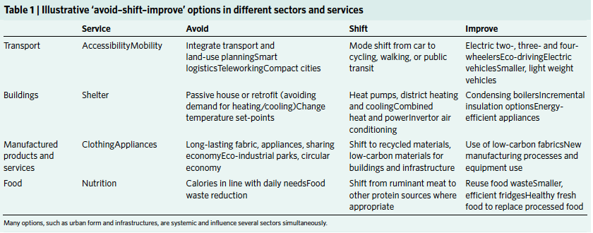
Avoid-Shift-Improve Framework
Originated in Germany in the 1990s with the objective of structuring transport policies to promote sustainable mobility.
Strategy functioning – dependent on country development levels (FEA 2012).

Slide 10
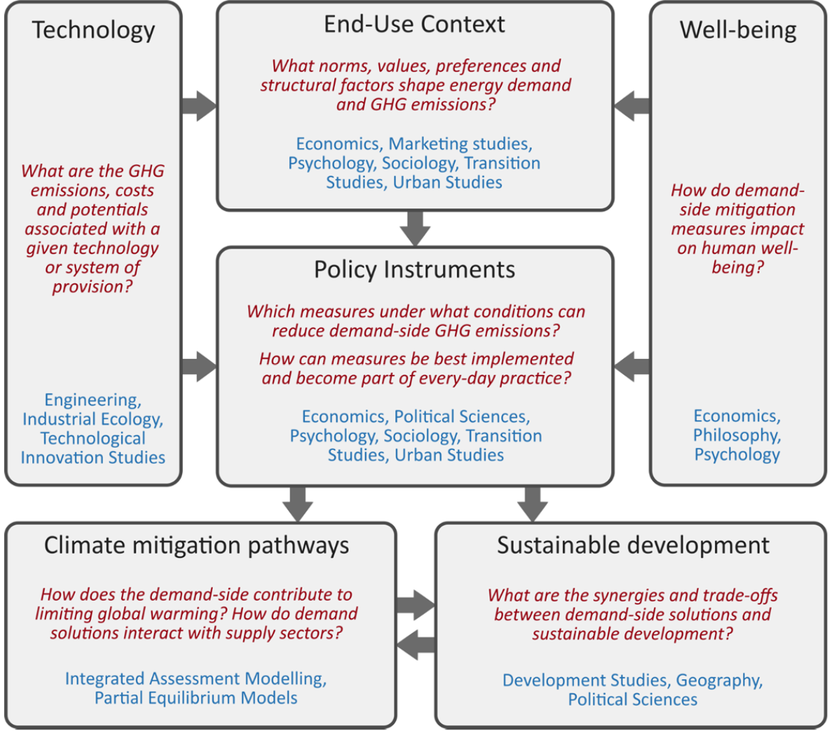

Slide 11
My PhD Focus
“Keeping up with the Joneses”
Landscape of demand-side solutions from emerging country perspective : India
Challenge: decarbonizing amongst national priorities of development and access, while part of the country also undergoes urbanisation and demographic change
Objectives:
Disentangle drivers of evolving urban energy consumption patterns
Role of status in household energy choices

Slide 12
Household Energy Consumption Analysis
Data: Indian Human Development Survey 2011-12
Sample : 14,573 urban households
Econometric Analysis
Factors influencing ownership of Car (Logit Regressions)
Factors influencing ownership of Appliances (Generalised Least Sq. Regression)
Factor Analysis
Variables: Household Appliances
Using Iterated Principle Factors to determine number of factors to use
Energy Intensive
Air conditioner, Washing Machine,
Microwave, Laptop, Computer
Intermediate/ Convenient
Air Cooler and Fridge
Basic
Electric Fan and Colour TV

Slide 13
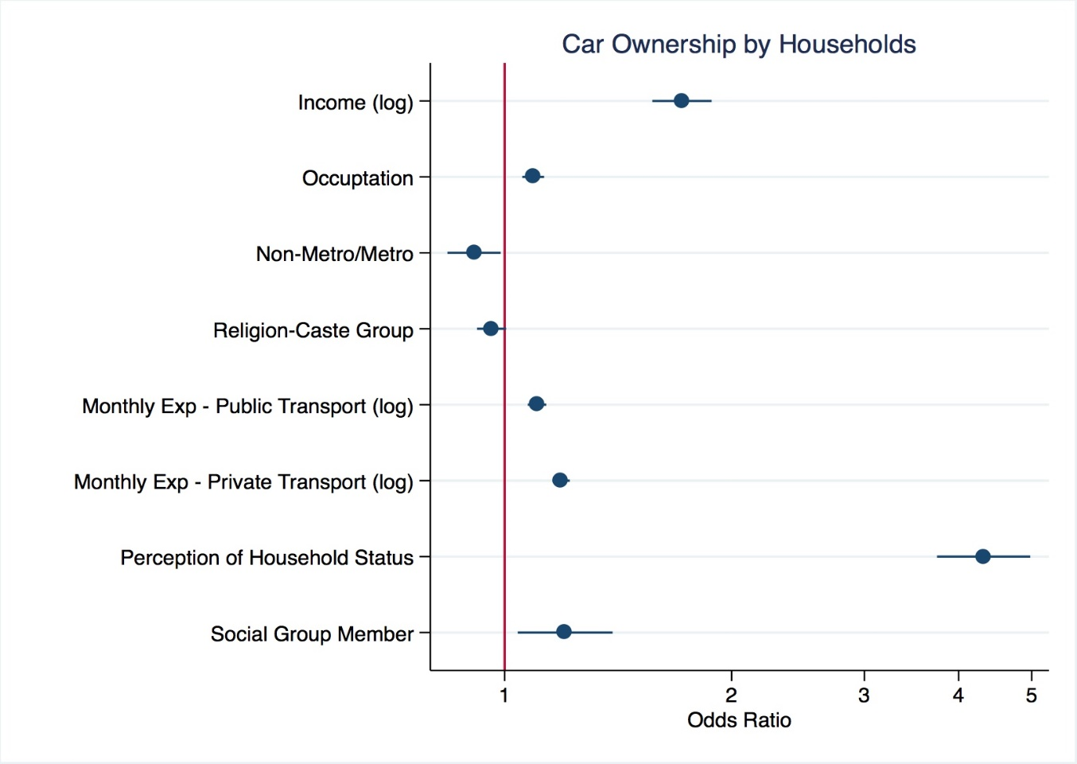
Regression Results
Economic Status – Increase in Income and better paying occupation profiles (Business) increases the odds of owning a car.
Dependent Variable: Y = 0, if household does not own a car
1, if household owns a car
Location (Metro effect)
Compared to non-metros, households
in Mumbai and Kolkata increase the odds of not owning a car by a factor of 6.25 and 1 respective, while households in Bangalore increases the odds of owning a car by a factor of 2.77.
Social identities and group memberships influence the odds of car ownership, but have opposing effects.
Perception of household status increases the odds of car ownership the highest – compared to perception of poor, middle class perception by factor of 4 and perceiving comfortable by factor of 16.
Notes:
This slide gives the regression results for a logit regression run to estimate the factors that influence the ownership of car by a household.
Off the 11 variables, the following have been significant. More importantly, the movement from non-metros to metro negative impacts the probability of car ownership. The impact is negative for Mumbai and Kolkata – the metros that have the oldest and better public transportations in the country. Quote the The Future of Urban Mobility 2.0 Report (2013) –ranks (descending) as per Urban Mobility Index as– Kolkata, Mumbai, Hyderabad, Chennai, Bangalore and Delhi. This could justify the sign of significance.
Secondly, the perception of HH status is a key insight – expand on this. There is low correlation between Income and HH status as per data. However, certain level of the status perception is influenced by the level of income. The direction if relationship is uncertain across the income classes.
Mathias & Nico – have you looked at a possible causality of car ownership leading to more income as well as higher perception. Panel

Slide 14
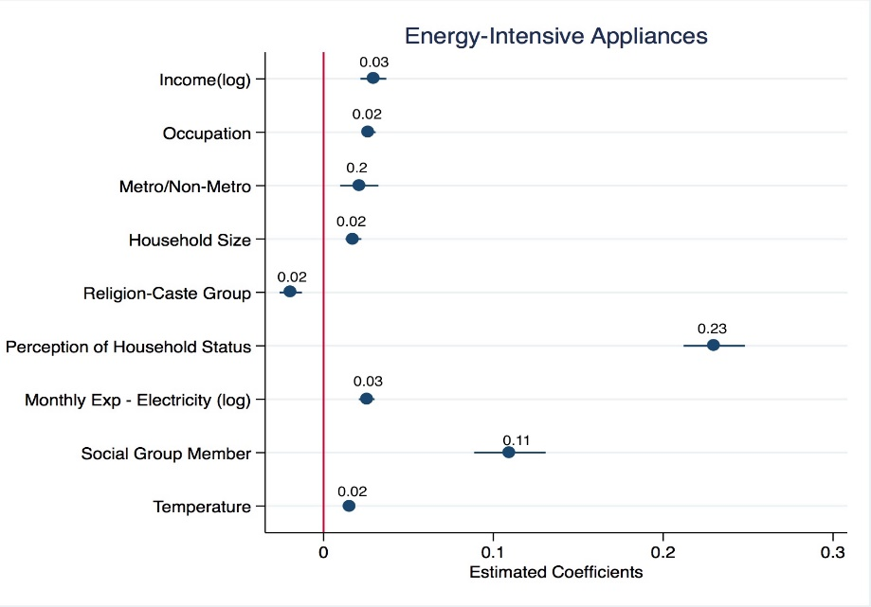
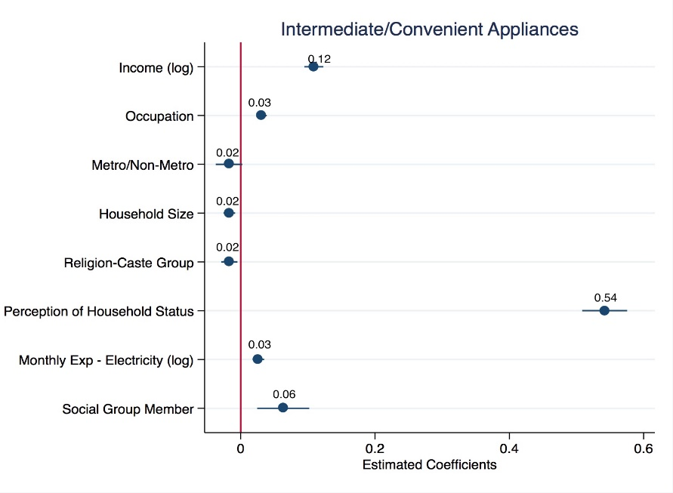
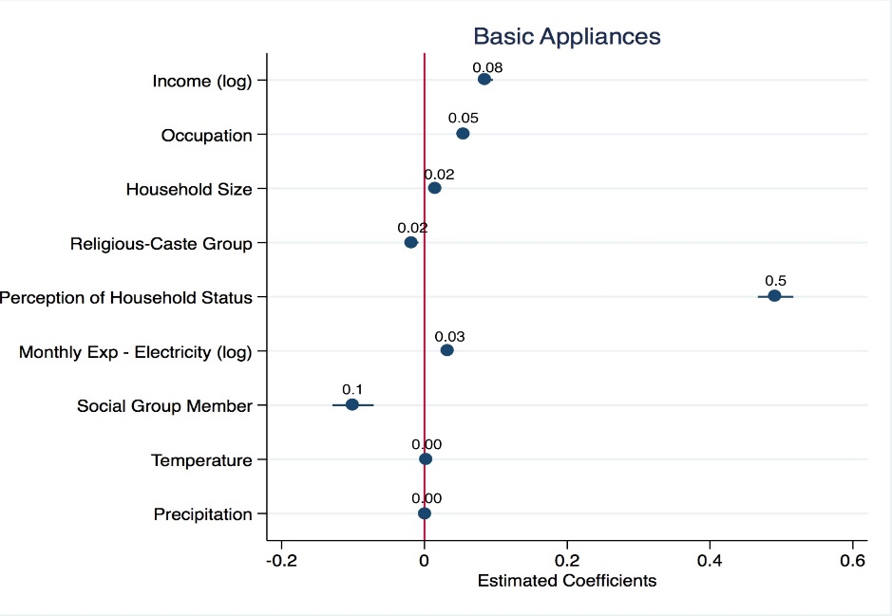
Regression Results
Dependent Variable
Y = Factor Score for Energy Intensive; Intermediate/Convenient and Basic
Positive for Mumbai, Chennai and Bangalore
Positive for Delhi and Bangalore, Negative of Mumbai and Chennai
Socio-economic, locational and climate factors are significant in influencing the ownership of appliances, while the household´s perceptions about their economic status has a large impact on household purchases of appliances
Notes:
While the perception of status, alongside other socio-economic and demographic has been constant – the location in a metro/non-metro and the precipitation levels have varied across the appliance categories.

Slide 15
- Consumption patterns are highly stratified within/across Indian cities.
- Status is an key latent driver of consumption among top consumers.
- Magnitude of socio-cultural attitudes and health-comfort targets are compelling high economic groups.
Gap in data: Future household surveys need to increase resolution on the status dimension
- Low Carbon Consumption a Status Symbol?
- Distinguishing between Necessary and Positional Consumption
Key Findings
Going Forward

Slide 16
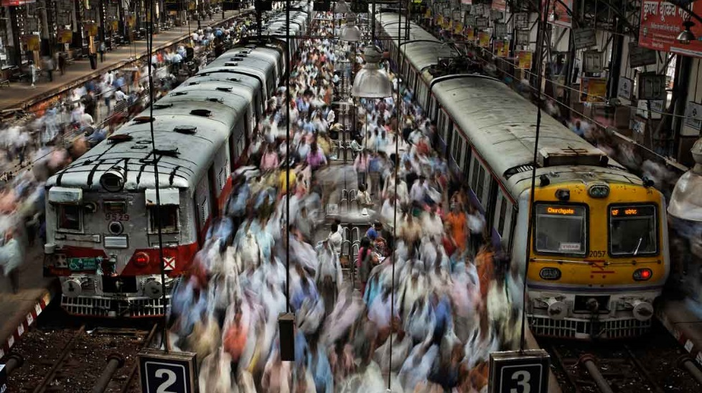
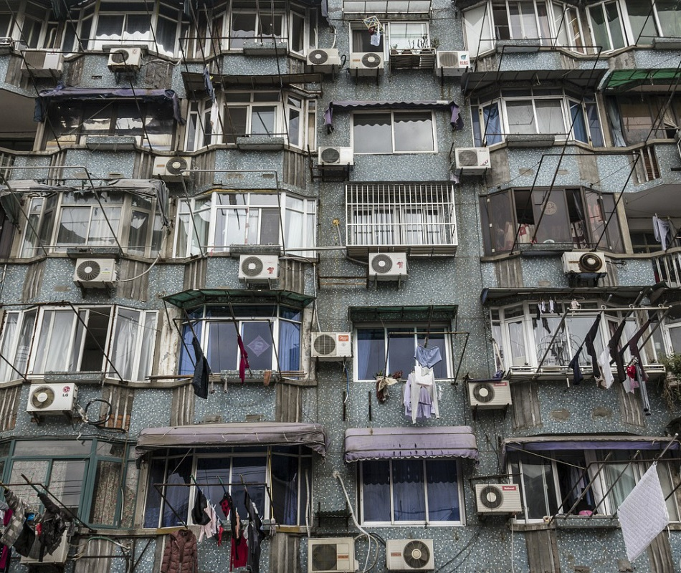
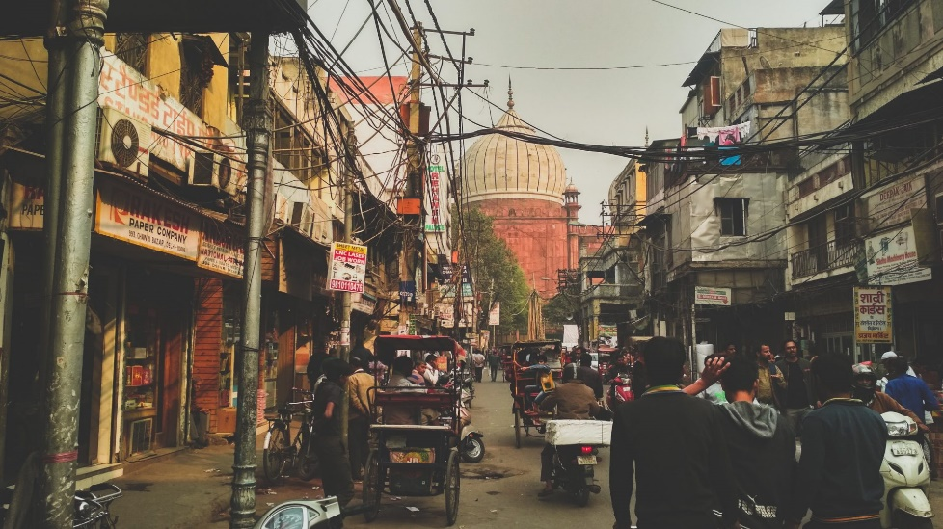

The widening “middle class” band requires thinking beyond incomes and delineate heterogeneity that accounts for differences in habits, attitudes and lifestyles and manifests itself in varying levels and patterns of energy use

